Slide 1
Don't Explain By: Jewelle Gomez

Slide 2
First Impressions?
Surprised?
Shocked?
Uncomfortable?

Slide 3
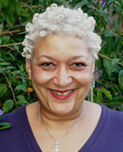
About the Author- Jewelle Gomez
"When I was a little girl, we sometimes found ourselves one person short when we tried to jump rope. One of us had to swing the end of the rope and the other was meant to jump-- but who was to swing the other end? Sometimes we'd make do by tying the rope onto a fence. Black feminists are like that fence-- nothing would happen without the fence, but who ever talks about it? You don't share photos of a fence or invite it to reunions." -Jewelle Gomez

Slide 4
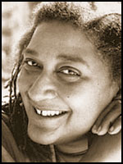
If you could say one thing to future butches and femmes, what would it be?
"There are many proud ways to be a woman and butch is one of them. Being a woman should not be confined to an advertiser’s fantasy, kewpie doll, feminine idealization of females. Being a woman includes coveralls, tool belts, short hair, low voices and any of the so-called ‘masculine’ things that we all know belong to women too."
- Jewelle Gomez
Website

Slide 5
Theme 1: Race, Class & Gender Hierarchy
“In essence, to be completely ‘normal,’ one must be White, masculine, and heretosexual, the core hegemonic White masculinity. This mythical norm is hard to see because it is so taken-for-granted. Its antithesis, its Other, would be Black, female, and lesbian, a fact that Black lesbian feminist Audre Lorde pointed out some time ago.” (Black Sexual Politics, Collins 96)
What are all women traditionally "supposed to" act like?
What are black women stereotypically "supposed to" act like?

Slide 6
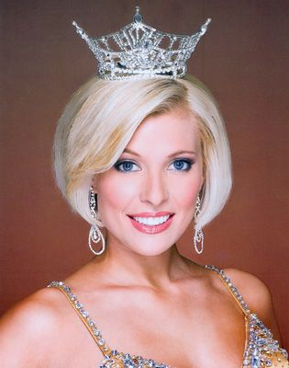
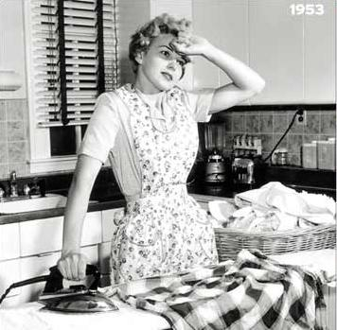
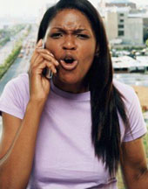
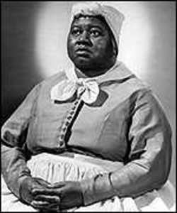
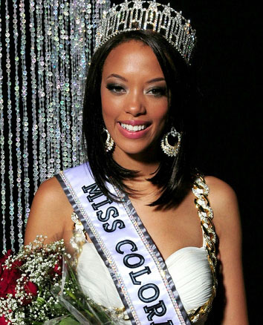

Slide 7
Theme 1 Questions
How does Steps refute the traditional roles/notions of Black women? pg. 36
How could you see this theme in Piece of Time? pg. 74

Slide 8
Theme 2: Identity: Race vs. Sexual Identity
“Is Gay the New Black?”

Slide 9
Theme 2 Questions
-What were the struggles Alberta faced throughout her relationship with Emma concerning this theme? (Water with the Wine)
- How does Lynx and Strand Eliminate the challenge of Race vs. Sexual Identity? pg. 145

Slide 10
Identify Black lesbians in society.

Slide 11
Theme 3:
Acceptance of Black Lesbians in Society
Oprah and Gayle
“In her book Feminism and Science Fiction, Sara Lefanu said, “For women, [speculative fiction] can be seen as allowing the expression of wish fulfillment” (1988, 76). For Black lesbians the wishes are a lot larger and richer than most people have been able to imagine. In our speculations about the future the vision of the struggle is often quite brutal, but the vision of the triumph is equally fantastic”. - Gomez (Angel)

Slide 12
Theme 3 Continued
Is there an acceptance of Black Lesbians in Society?
How is there an acceptance of Black Lesbians in Don't Explain (short story)?
Is there any instance in the novel where Black Lesbians are not accepted? How does this reflect within society?

Slide 13
Theme 3 Questions
How does Letty find acceptance as a Black Lesbian in Don't Explain? pg. 25-28
Explain how Gomez uses Speculative Fiction with the book to demonstrate acceptance of Black Lesbians in society? (Lynx and Strand, Houston)

Slide 14
Sources
Collins, A. (2005). Black sexual politics. New York: Taylor and Francis Group.
Gomez, J. (1998). Don't explain. New York: Firebrand Books.
Gomez, J. (1993). Speculative fiction and black lesbians.Signs, 18(4), 948-955.
Gomez, J. (n.d.). Retrieved from http://www.jewellegomez.com/
Gomez, J. (n.d.). Retrieved from http://goldencrown.org/Default.aspx?pageId=1176669
Lorde, A. (1984). Sister outsider.
(n.d.). Retrieved from http://persistenceanthology.tumblr.com/post/3356149208/contributor-mini-interview-jewelle-gomez
YouTube

